Slide 1
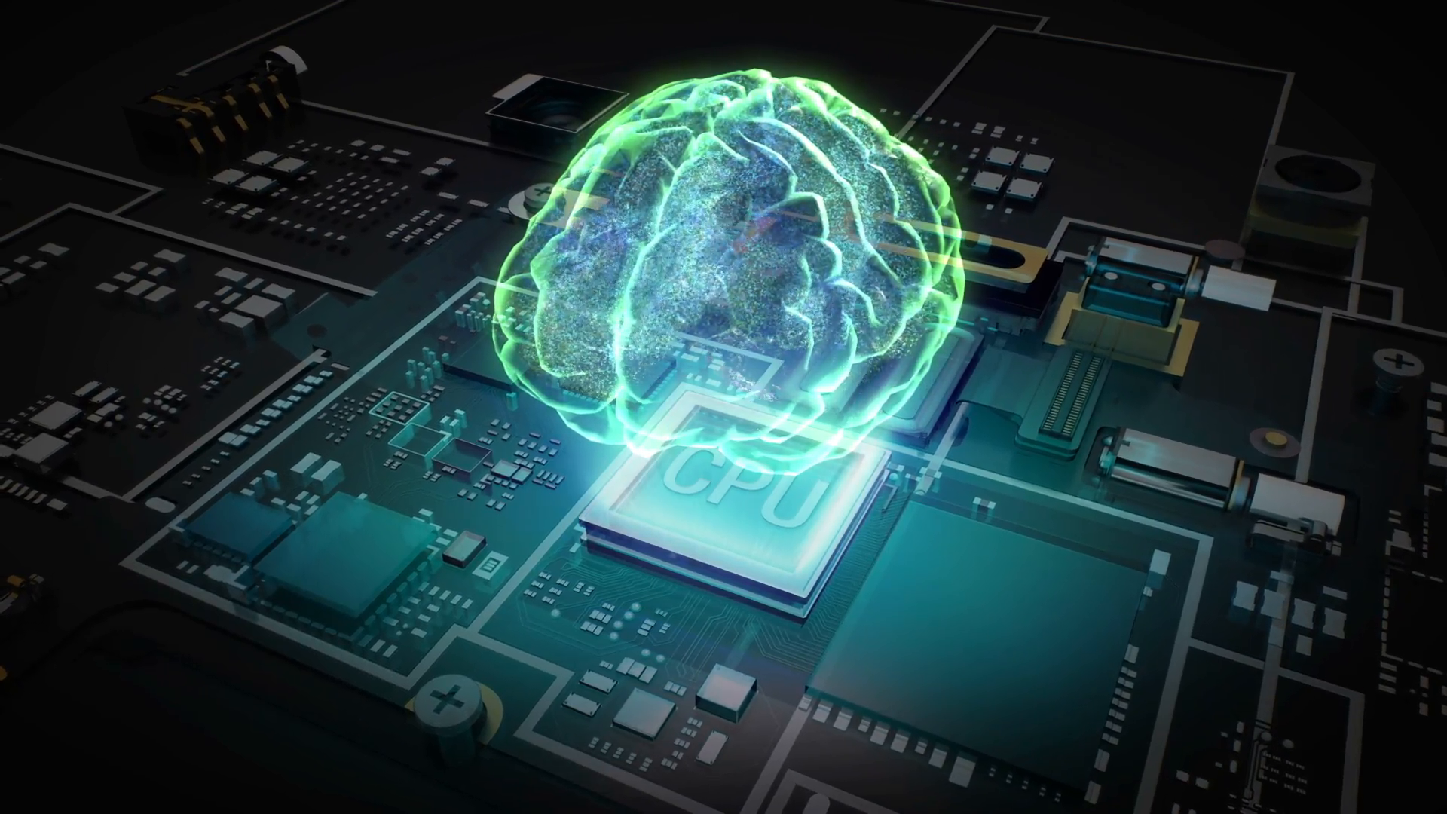
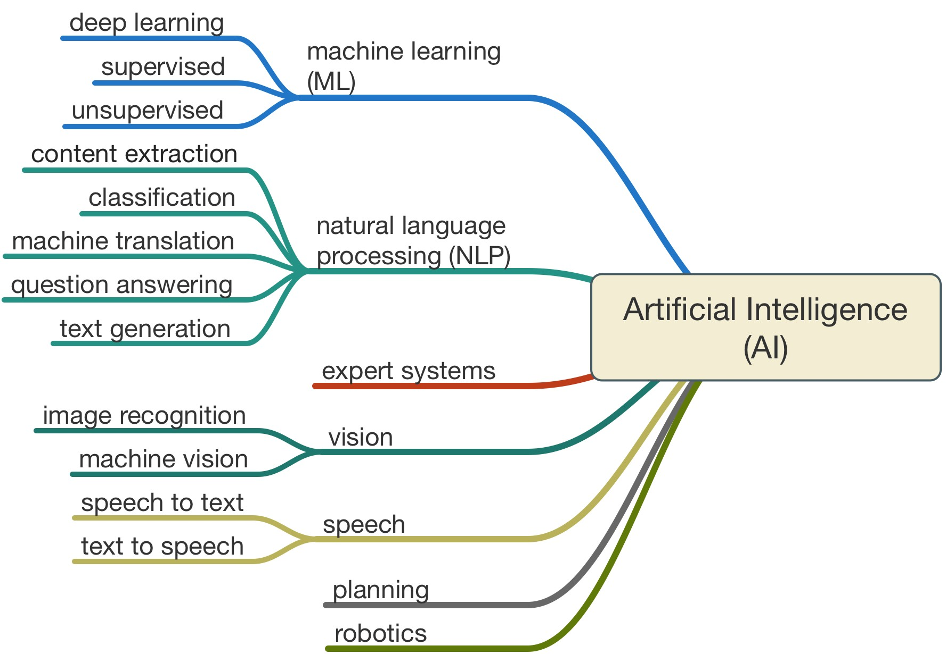
Artificial intelligence
- Part 1
10/10/2021
Jose Peeterson

Slide 2
The Power of AI – LSTM & CNN
Pose detection - AlphaPose
Object detection – YOLO, FASTER RCNN
Please see youtube video for videos.

Slide 3
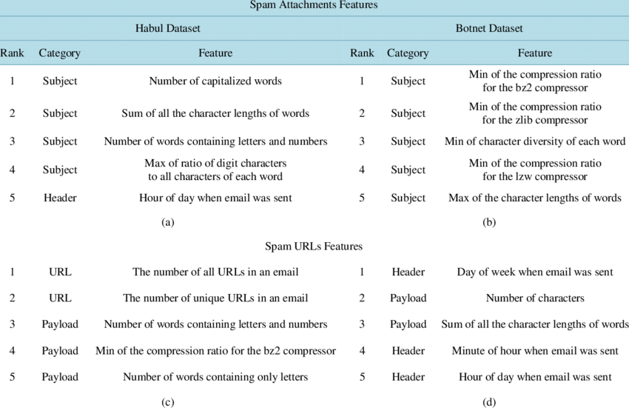
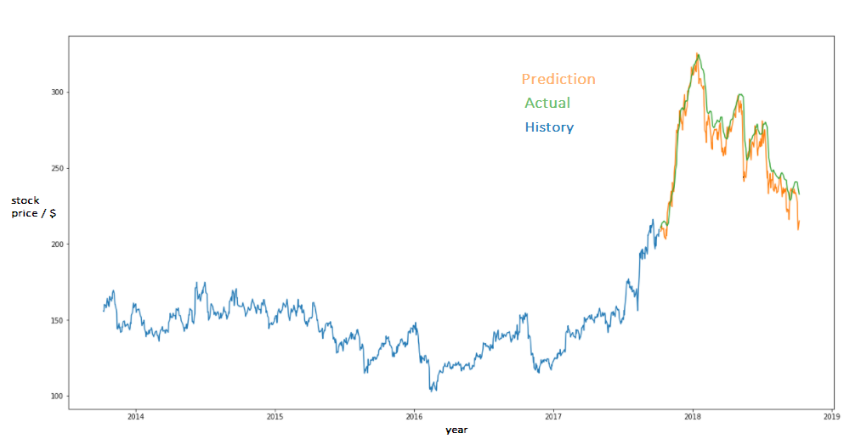
The Power of AI – Common tasks
Classification
  Fraud detection, Spam Email detection
Regression
  Time series Forecasting, stock price prediction

Slide 4

The Power of AI – Common tasks
Natural Language Processing
    (based on Recurrent Neural Networks)
  Machine translation
  Chat bots
  Code generation
      OpenAI Codex (*Palindromes are strings that read the same in both directions. E.g. MADAM, 123321)
Computer vision
    (based on Convolutional Neural Networks)
  Face detection and tracking, virtual spectacles

Slide 5
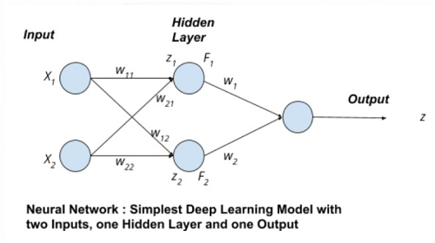
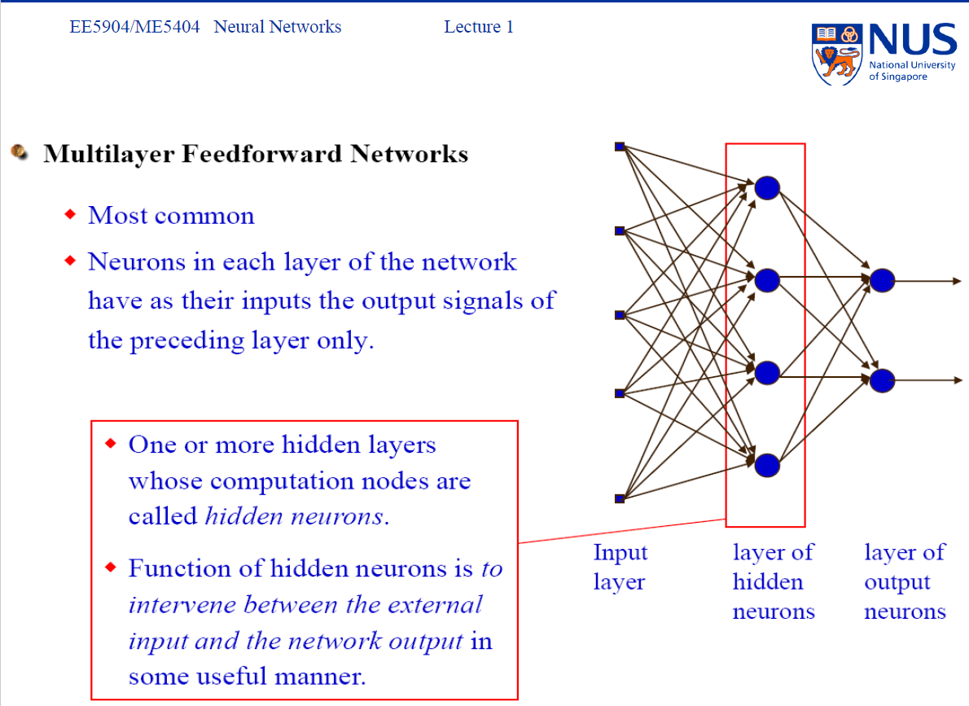
Under the bonnet of AI -> NEURAL NETWORKS (NN)
Neurons are also called perceptrons
Neural Networks
Example of 5 INPUT and 1 OUTPUT
No. | Drinker/ (yes or no) | Age/ (years) | Average speed/ (Km/h) | Type of car/ (sports or normal) | Family (yes or no) | Target /(1) or (0)
1 | 1 | 28 | 85 | 1 | 0 | High risk
2 | 0 | 45 | 45 | 0 | 1 | Low risk
3 | 1 | 23 | 30 | 0 | 1 | Low risk
4 | 0 | 65 | 35 | 0 | 1 | Low risk
5 | 0 | 25 | 70 | 1 | 0 | High Risk
6 | 0 | 24 | 55 | 0 | 1 | Low risk

Slide 6
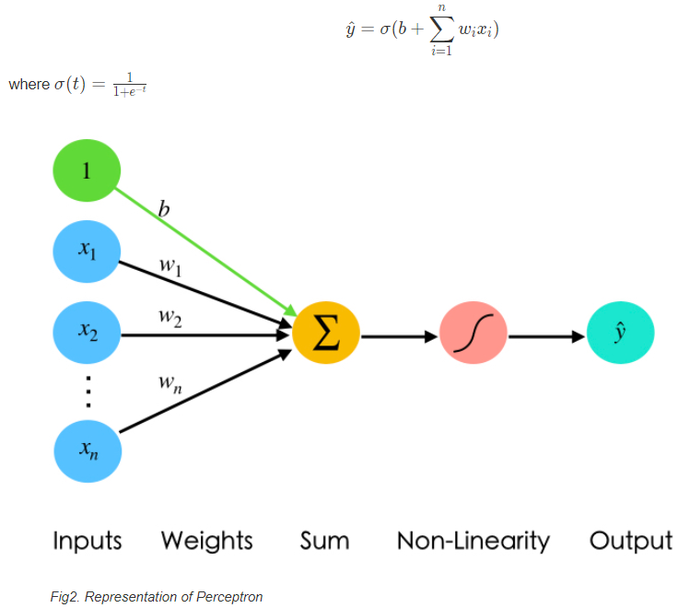
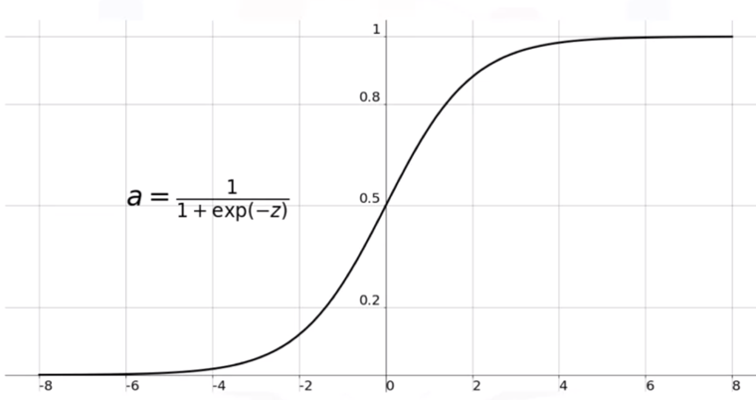
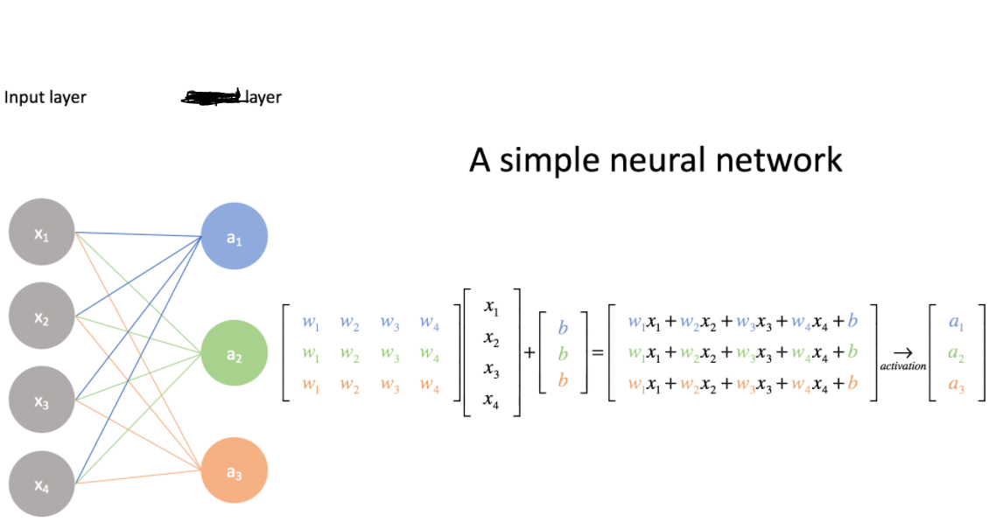
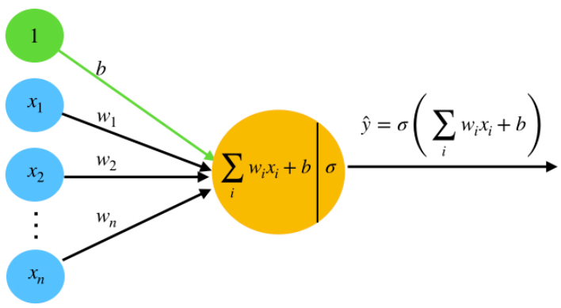
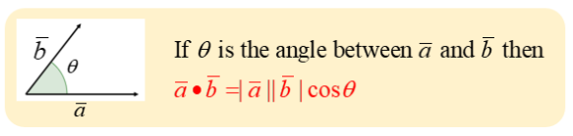
Under the bonnet of AI -> NEURAL NETWORKS (NN)
Perceptron structure, weights vector
A weights matrix is formed by augmenting all the weight vectors of each perceptron in a layer. Every layer has a weights matrix.
Certain neurons fire if inputs are aligned with their weights. Similar to a dot product.

Slide 7
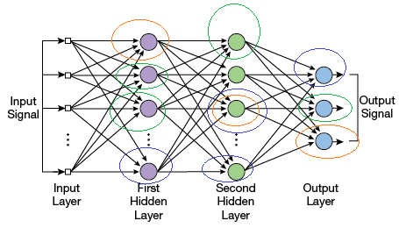
Under the bonnet of AI -> NEURAL NETWORKS (NN)
Different neurons learn different aspects from input data. Which neuron learns what depends on its random weights initialization.
Neurons that fire together, wire together. Necessary that these neurons are connected all the way to the output neurons.
Weights of the neurons amplify the input signal and connect that input signal through the neurons of the different layers all the way to the correct neuron that correctly classifies the input signal.
OUTPUT of a NN is a prediction/classification.
The circles of same colour indicate the neurons that fire for a particular class.n

Slide 8
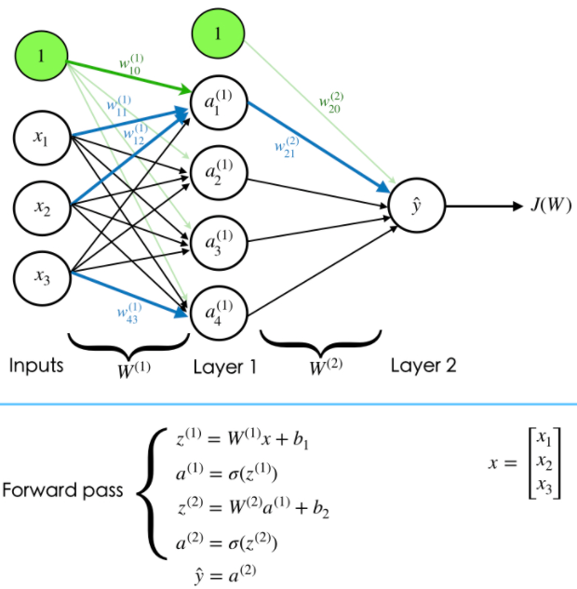


Training - Forward Pass (1st step in iteration)
Randomly initialize weights close to zero and choose a training sample
Perform matrix multiplication and compute prediction
We have to supervise the training process through ground-truth or target
so that we can correct the network each time it makes a mistake.
Loss function is to Evaluate the "goodness" of our predictions,
  Mean squared error LOSS
    Loss function is a function of all the weights from all the layers (i.e. multivariable function).
Initially, during the first few iterations, the loss will be high as the weights have not learnt the different aspects or representations of the input data that correspond to a particular class of output.

Slide 9

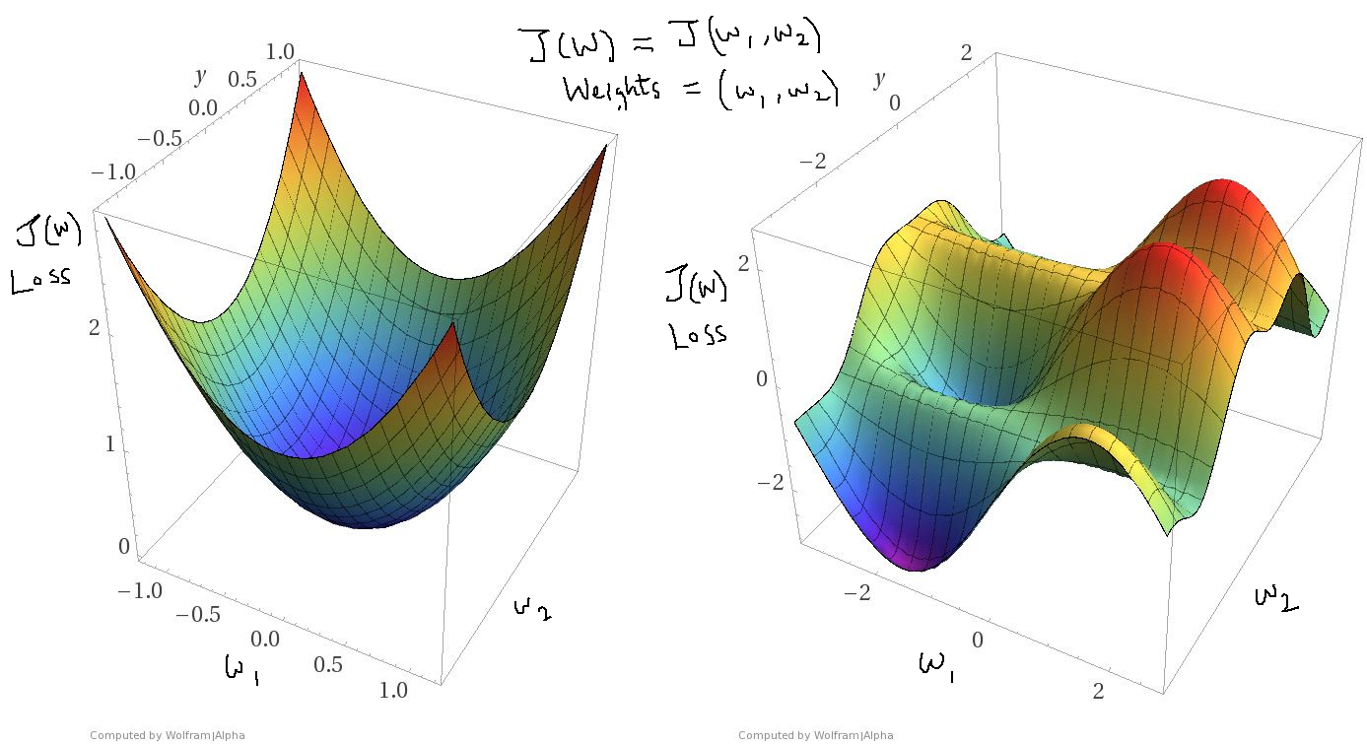
Training - Gradient Backpropagation, Learning!! (2nd step in iteration)
How can we change/update the weights such that the loss can be minimized?
Perform stochastic Gradient descent on the loss surface generated by each sample
Loss surface
  https://losslandscape.com/
  Weight update mechanism

Slide 10
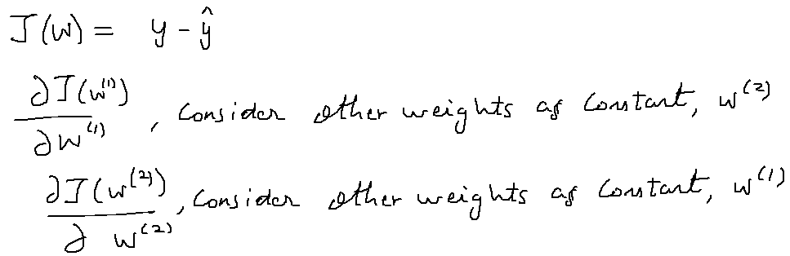

Training - Gradient Backpropagation, Learning!! (2nd step in iteration)
Find the derivative of the loss at the present weight values.
Derivative of a multivariable loss function/surface gives the direction of steepest ascent on the loss surface at the present weights.
Update weights

Slide 11
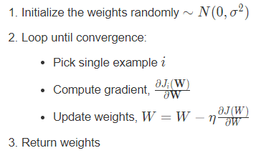
Training – Iteration stopping criteria (Last step in iteration)
Go back to 1st step and perform a forward pass on a new data sample with updated weights. Compare the prediction with ground-truth to find loss. Is the loss converging to 0?
If Yes, Stop. Learning is complete. Continue to test on untrained data.
If No, Perform Forward pass and continue iteration.
Source: For the 3 steps
Neural network working example on unstructured data such as an image.

Slide 12
AI development process summary
Data gathering
  Structured data (tabular form) or Unstructured data (images, sound or sentences)
  Structured (Unstructured) data often do not require (does require) feature extraction before training
  Training data should be comprehensive (varied) enough to capture the underlying data distribution
  Removal of outliers and biases is necessary to have a loss surface that is continuous (differentiable, (also called learning).) with fewer local minima.
  Split data into training set and testing set such that both sets are mutually exclusive.
Training
  Iteratively perform forward pass, backpropagation and compute loss until loss is ~= 0.
Validation
  Helps to choose hyperparameters like structure of network. i.e. Number of neurons in each layer.
Testing
  Strength of NN as opposed to other rule-based algorithms lies in its ability to generalize well to unseen data.

Slide 13
Resources to learn about AI
Mathematical Prerequisites:
  Calculus (incl. Multivariable differential calculus)
  First course in Linear Algebra (basics incl. matrix operations)
  First course in Probability(basics incl. bayes theorem)
AI research information
  https://openai.com/
Online resources
  https://machinelearningmastery.com/
  https://towardsdatascience.com/conda-google-colab-75f7c867a522
  kaggle.com
  https://realpython.com/
  https://www.youtube.com/c/joshstarmer
Where can I learn about AI and be certified?
  Coursera
  Deep Learning Specialization
  IBM Data Science
  IBM AI

Slide 14
THE END
THANKS FOR YOR ATTENTION!!

